Slide 1
Lesson 4: Congruence Statements (CPCTC) & 5 Ways to Prove Triangles Congruent
Analytic Geometry
Unit 1: Similarity, Congruence & Proofs

Slide 2
Congruent Triangles
Congruent triangles have ___congruent ____ and __ congruent _________.
The parts of congruent triangles that “match” are called __________________.
3
SIDES
3
ANGLES
CORRESPONDING PARTS

Slide 3
Congruence Statement
In a congruence statement
ORDER MATTERS!
Everything needs to match up!
Triangle AUG is congruent to triangle DAY

Slide 4
CPCTC
Corresponding Parts of Congruent Triangles are Congruent

Slide 5
Complete each congruence statement.
B
A
C
D
F
If ΔABC ≅ ΔDEF,
then BC ≅ ___
EF
E

Slide 6
Complete each congruence statement.
B
A
C
D
F
If ΔABC ≅ ΔDEF,
then ∠A ≅ ___
∠D
E

Slide 7
Complete each congruence statement.
B
A
C
D
F
If ΔABC ≅ ΔDEF,
then ∠C ≅ ___
∠F
E

Slide 8
Fill in the blanks
If ΔCAT ≅ ΔDOG,
then AC ≅ ___
OD

Slide 9
Fill in the blanks
ΔBAT ≅ ΔMON
∠N
∠T ≅ ___
_____ ≅ ∠ONM
_____ ≅ MO
NM ≅ ____
∠ATB
BA
TB

Slide 10
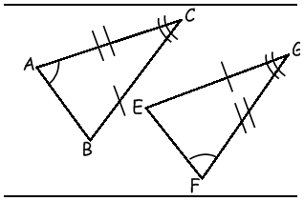
Fill in the blanks
EGF
ΔBCA ≅ Δ ____
Δ____ ≅ Δ GFE
CAB

Slide 11
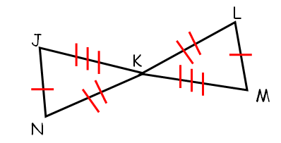
Complete the congruence statement.
Δ_____ ≅ Δ JKN
MKL

Slide 12
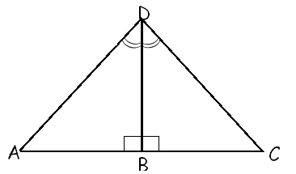
Complete the congruence statement.
ABD
Δ_____ ≅ Δ CBD

Slide 13
There are 5 ways to prove triangles congruent.
SSS, SAS, AAS, ASA & HL

Slide 14
Side-Side-Side (SSS) Congruence Postulate
If the three sides of one triangle are congruent to the three sides of another triangle, then the two triangles are congruent.

Slide 15
Side-Angle-Side (SAS) Congruence Postulate
If two sides and the included angle of one triangle are congruent to the two sides and the included angle of another triangle, then the two triangles are congruent.

Slide 16
Angle-Angle-Side (AAS)
Congruence Postulate
A
A
A
A
S
S
If two angles and a nonincluded side of one triangle are congruent to two angles and the corresponding side of another triangle, then the triangles are congruent.
Two Angles and One Side that is NOT included

Slide 17
Angle-Side-Angle (ASA) Congruence Postulate
A
A
S
S
A
A
If two angles and the included side of one triangle are congruent to two angles and the included side of another triangle, then the two triangles are congruent.

Slide 18
Hypotenuse Leg
HL
If the hypotenuse and a leg of one right triangle are congruent to the hypotenuse and leg of another right triangle, then the triangles are congruent.

Slide 19
SSS
SAS
ASA
AAS
HL
NO BAD WORDS
Only Ways To Prove Triangles Are Congruent

Slide 20
2 markings you can add if they aren’t already marked

Slide 21
Share a side
Reason: reflexive property
Vertical Angles
Reason: Vertical Angles are congruent

