Slide 1
Lesson 3: Quadrilaterals & Parallelograms
Analytic Geometry
Unit 1: Similarity, Congruence & Proofs

Slide 2
Parallelogram
2 pairs of opposite sides are parallel
2 pairs of opposite sides are ≅
2 pairs of opposite angles are ≅
Consecutive angles are supplementary
Diagonals bisect each other
∠A+∠B=180 ∠C+∠B=180
∠A+∠D=180 ∠C+∠D=180

Slide 3
Rectangle
All properties of a Parallelogram plus
Diagonals are ≅
4 ≅ right angles
AC≅ DB

Slide 4
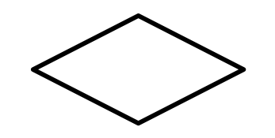
Rhombus
All properties of a Parallelogram plus
Diagonals are perpendicular (they make 90 degrees)
Diagonals bisect opposite angles
4 ≅ sides

Slide 5
Square
All properties of a Parallelogram plus
All properties of a Rectangle plus
All properties of a Rhombus
AC≅ DB

Slide 6
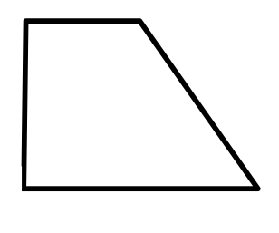
Trapezoid
Exactly 1 pair of parallel sides

Slide 7
Isosceles Trapezoid
Exactly 1 pair of parallel sides
Base angles are ≅
Opposite angles are supplementary
1 pair of ≅ legs
Diagonals are ≅
AC≅ BD
∠A+∠B=180 ∠C+∠B=180
∠A+∠D=180 ∠C+∠D=180

Slide 8
Kite
2 pairs of consecutive sides are ≅
1 pair of opposite angles are ≅
Diagonals are perpendicular

Slide 9
Helpful formulas
Slope Formula: Given the two points (x₁, y₁) and (x₂, y₂)
Distance Formula: Given the two points (x₁, y₁) and (x₂, y₂), the distance between these points is given by the formula:

