Slide 1
Find the Area

Slide 2
Lesson 24: Chord Properties & Segment Lengths

Slide 3
If two chords are congruent, then their corresponding arcs are congruent.

Slide 4
Solve for x.
8x – 7
3x + 3
8x – 7 = 3x + 3
x = 2

Slide 5
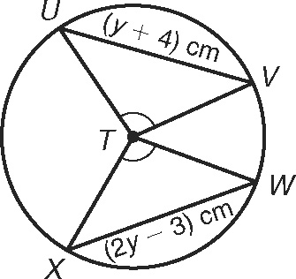
Find the length of WX.

Slide 6
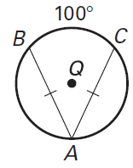
Find
360 – 100
260 divided by 2
130º

Slide 7
If two chords are congruent, then they are equidistant from the center.

Slide 8
In K, K is the midpoint of RE. If TY = -3x + 56 and US = 4x, find the length of TY.
U
T
K
E
x = 8
R
S
Y
TY = 32

Slide 9
If a diameter is perpendicular to a chord, then it also bisects the chord. This results in congruent arcs too. Sometimes, this creates a right triangle & you’ll use Pythagorean Theorem.

Slide 10
IN Q, KL ≅ LZ. If CK = 2x + 3 and CZ = 4x, find x.
Q
x = 1.5
C
Z
K
L

Slide 11
In P, if PM ⊥ AT, PT = 10, and PM = 8, find AT.
A
P
M
8
10
MT = 6
T
AT = 12

Slide 12
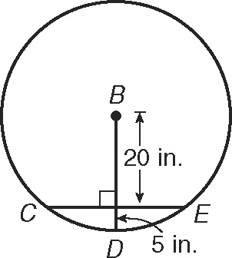
Find the length of CE
BD is a radius.
CB is a radius.
What is the length of the radius?
25
Now double it to find CE.
30
25
x

Slide 13
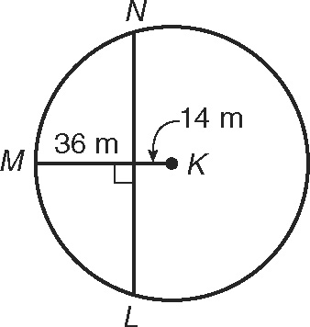
Find the length of LN.
MK and KL are radii.
Now double it to find LN.
x
50
LN = 96

Slide 14
Segment Lengths in Circles

Slide 16
Two chords intersect
INSIDE the circle
Type 1:
part
part
part
part
Go down the chord and multiply
Notes:
Emphasize that the chords are NOT congruent or bisected!

Slide 17
Solve for x.
9
6
x
2
x = 3

Slide 18
Find the length of DB.
A
12
D
2x
x = 4
8
3x
C
DB = 20
B

Slide 19
Find the length of AC and DB.
D
A
x – 4
x
5
C
10
x = 8
AC = 13
DB = 14
B

Slide 20
Two secants intersect
OUTSIDE the circle
Type 2:
Sometimes you have to add to get the whole.

Slide 21
Solve for x.
20
x = 31
7
4
x
7
(20)
=
(4 + x)
4
140 = 16 + 4x
124 = 4x

Slide 22
Solve for x.
x = 11.8
x
5
8
6
6
(6 + 8)
=
5
(5 + x)
84 = 25 + 5x
59 = 5x

Slide 23
Solve for x.
(x – 6)(x + 16) = 0
10
x = 6
x
4
8
x
(x + 10)
=
(8 + 4)
8
x² +10x = 96
x² +10x – 96 = 0

Slide 24
Type 2 (with a twist):
Secant and Tangent

Slide 25
Solve for x.
x
12
24
x = 36
24²
=
12
(12 + x)
576 = 144 + 12x
432 = 12x

Slide 26
Solve for x.
5
15
x
x = 10
x²
=
5
(5 + 15)
x² = 100

Slide 27
Practice
Workbook Page 232

Slide 28
Homework
Worksheet

